Slide 1
Learning Java
Durban Session 2018
Dennis Löhmann / Eva Kullová
by South Africa Challenge

Slide 2
Chapter 1
Starting with Java
What is Java?
Install Software
Write your first Program

Slide 3
More Resources for learning
Tools
Find this on GitHub

Slide 4
Lesson 1.1
What is Java?
Java is a programming language and computing platform first released by Sun Microsystems in 1995.
There are lots of applications and websites that will not work unless you have Java installed, and more are created every day. Java is fast, secure, and reliable. From laptops to datacenters, game consoles to scientific supercomputers, cell phones to the Internet, Java is everywhere!
It is used by 90% of the Fortune 500 Companies.
Java is platform –independent, has a good failure safety and is easy to learn.

Slide 5
Lesson 1.1
What is Java?
Java is platform –independent ...
Java is a true programming language, that means it is compiled into bytecode before you can run it (JavaScript is a completely different thing: it runs in the browser and is interpreted during runtime – interpreted languages are slower). Java runs on a Virtual Machine, that provides an adapter to the operating system.
... has a good failure safety ...
You won‘t get a segmentation fault, but an exception that you can catch and handle. Also the Java VM does all the memory management for you. A module called garbage collector cleans up the memory for you
... and is easy to learn.
So why not start today? Java and the IDE Eclipse can be downloaded for free!

Slide 6
Lesson 1.2
Install Eclipse
Download Eclipse from http://www.eclipse.org/downloads/
Unpack the package and start eclipse.exe
Download latest Java JDK from Oracle
Set Path Variable JAVA_HOME

Slide 7
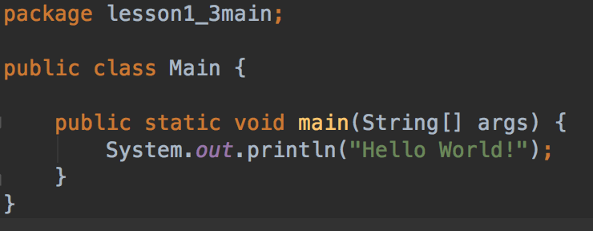
Lesson 1.3
Your first program
Minimum program needs:
package: directory structure class: base datatype in Java main method: always executed at start
System.out.println() prints to the console

Slide 8
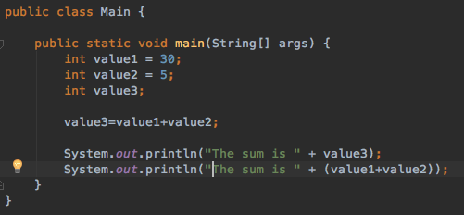
Lesson 1.4
Data Types: Integer
Integer values represent numbers
to declare a variable, use the following format: <type> <name> = <value>
variable names start with a small letter

Slide 9
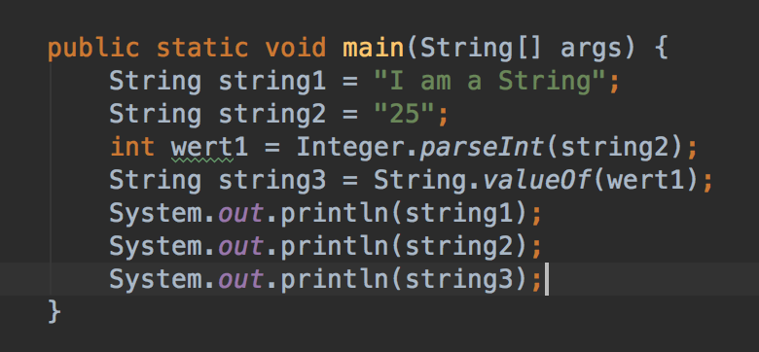
Lesson 1.5
Data Types: String and Typecasting
Strings represent a text data type
Other data types can be converted to String or parsed from Strings.

Slide 10
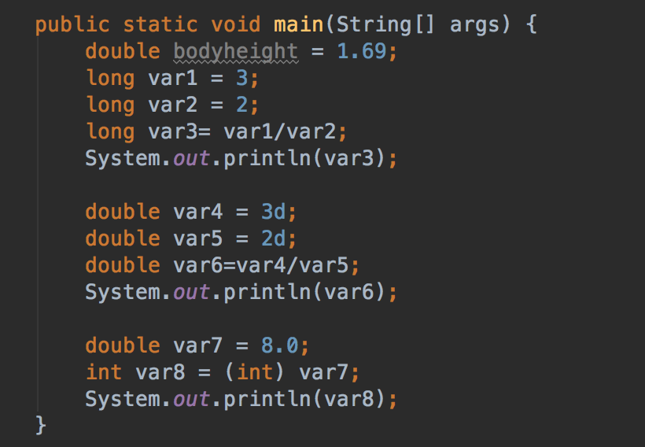
Lesson 1.6
Data Types: Double and others
Doubles are Floating-Point numbers. Can be used for more precision

Slide 11
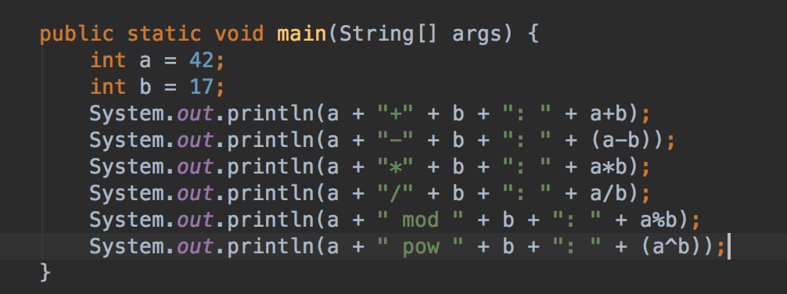
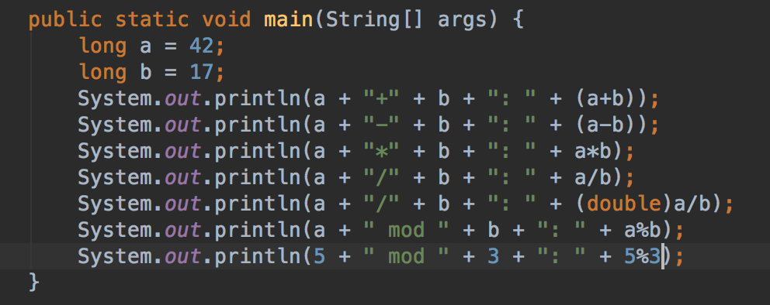
Lesson 1.7
Mathematical Operations
+ addition - minus / division * multiplication
% (called Modulo) calculates the division remainder

Slide 12
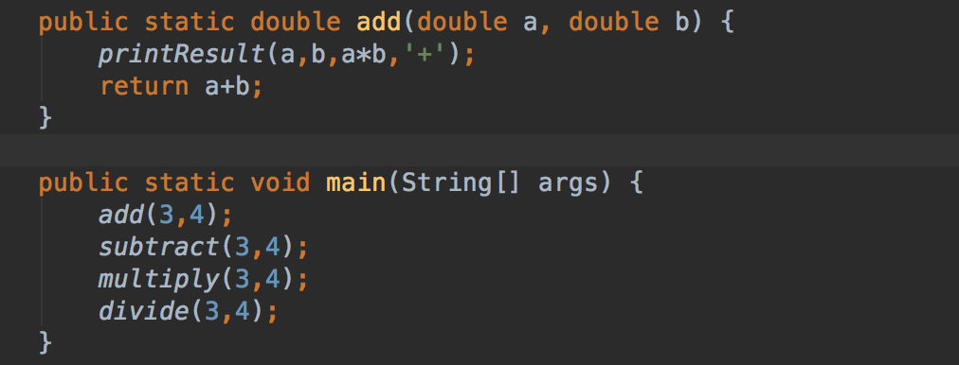
Lesson 1.8
Methods and Parameters
A method is used to abstract basic operations and give them a name.
Instead of repeating a sequence of operations again and again, just call the method

Slide 13
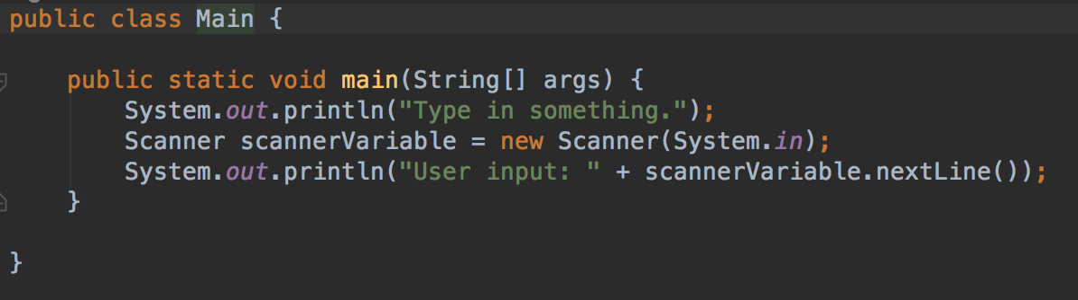
Lesson 1.9
User Input
A Scanner is a simple utility to get data from user input
System.in prompts the user for input on the command line.

Slide 14
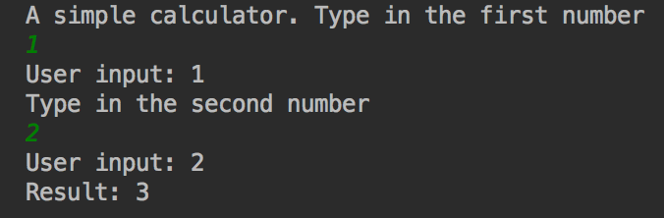
Practice 1
Write a simple calculator
Write a simple calculator that takes two user inputs and prints a result.
Use the Scanner class and parse the integers from the input.

Slide 15
Chapter 2
Decisions

Slide 16
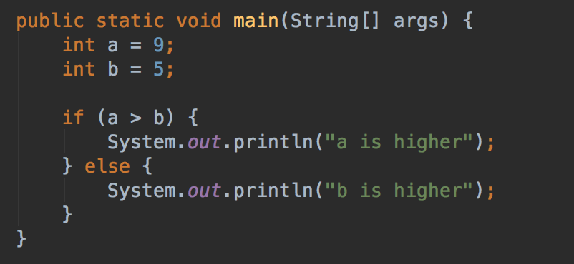
Lesson 2.1
What if, and what else?
The if clause is used for decisions
Structure: if – then – else
You can omit the curly braces, but then only first statement is executed

Slide 17
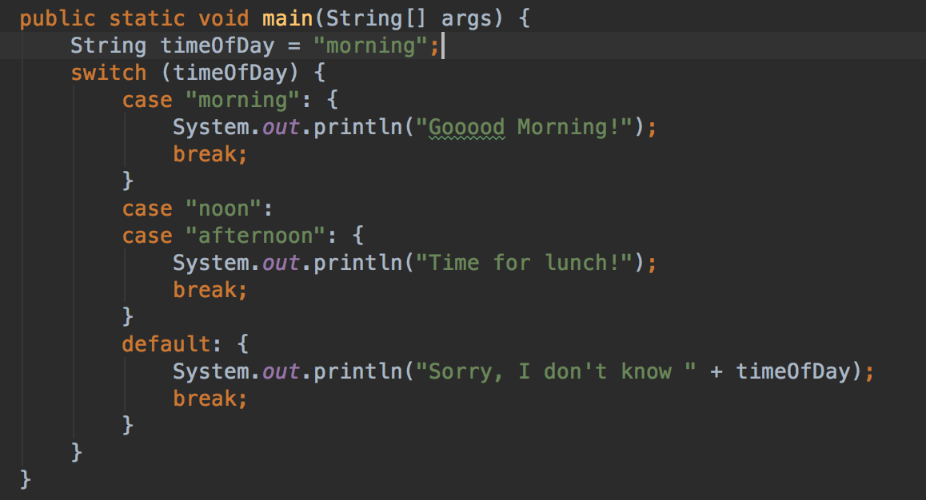
Lesson 2.2
Switch / Case
Use a switch instead of a sequence of if‘s
Structure is :
switch(variable) { case condition: { statement_1 .. statement_n } break; }
Default statement is executed if no condition meets

Slide 18
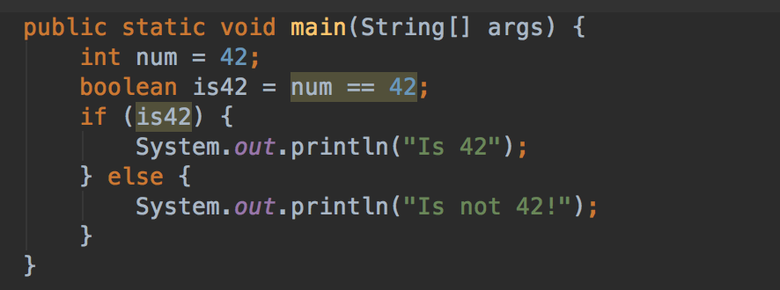
Lesson 2.3
The Boolean Operator
The boolean operator can only have two states: true or false
Uses only one bit of memory.
Can be used to store a state

Slide 19
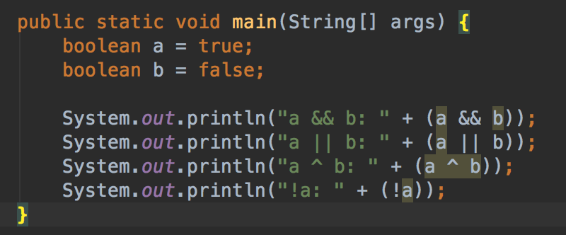
Lesson 2.4
Logical Operators
Logical operators are used to combine boolean statements
a && b: a and b are true
a || b: a or b is true or not
a ^ b: XOR: either a or b is true, but not both
!a: a is not true

Slide 20
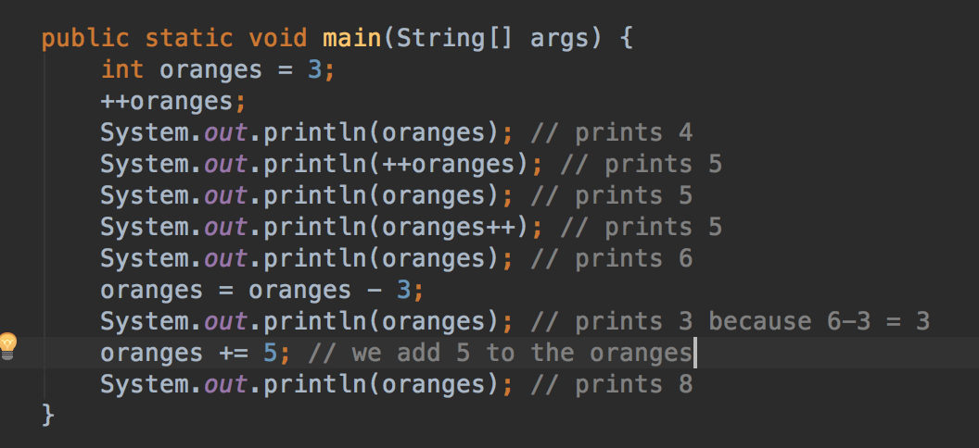
Lesson 2.5
Increment Operator
i++ is a shorthand for i = i+1
i += x is a shorthand for i = i+x

Slide 21
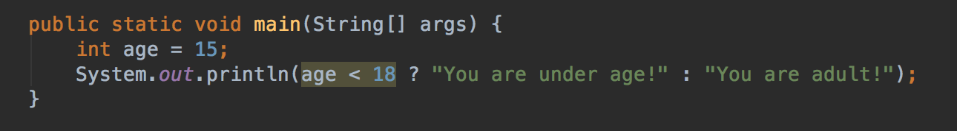
Lesson 2.6
Conditional Operator
a ? op1 : op2
is a shorthand for
If (a) {op1} else {op2};
And can be used inline:

Slide 22
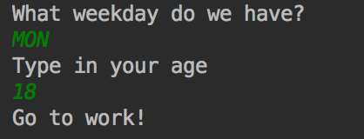
Practice 2
Write a program that makes a decision
As a user, I want to know from my program whether I should go to work, or to school, or relax.
- The user will provide the program with the weekday.
- The program prints out “Go to work” on weekdays and “Relax” on the weekend.
- Weekdays are: MON, TUE, WED, THU, FRI
- Weekends are: SAT, SUN
- Provide a message “Weekday unknown” if someone enters an invalid day.
Bonus part: let the user provide the age as well. If under 18, show “Go to school” on the weekdays instead

Slide 23
Chapter 3
Loops

Slide 24
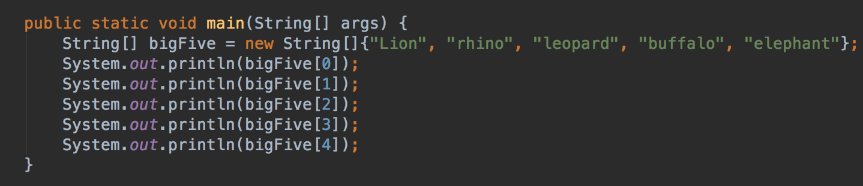
Lesson 3.1
Arrays
An Array is a data structure to store multiple values of one data type.
Has fixed size
Numbering starts with 0
String bigFive = new String[5]; would initialize empty array

Slide 25
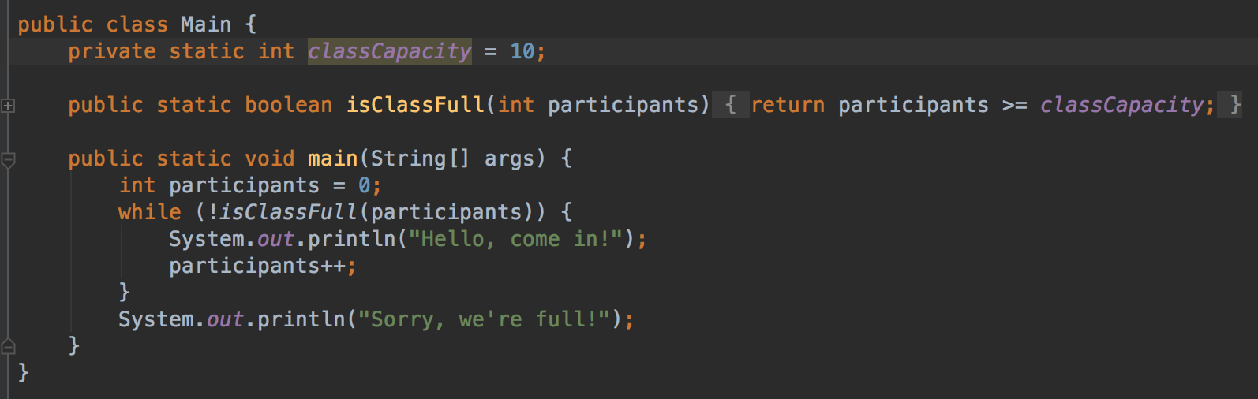
Lesson 3.2
Do-While Loops
A while loop is repeated as long as a specific condition is met
While (condition) { do; }

Slide 26
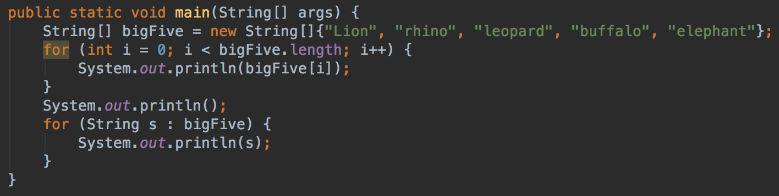
Lesson 3.3
For Loops
A for loop is repeated as long as a specific condition is met, but provides an iteration variable
for (variable; condition; iteration) { do(variable); }

Slide 27
Practice 3
Write a program that takes an array of numbers and calculates the sum of these.
The array can have any size.
Provide a method private static int sum(int[] numbers) { ... }

Slide 28
Chapter 4
Classes and Objects
Classes and Objects provide complex data types to model entities of the real world
They can have properties, methods and also a hierarchy.

Slide 29
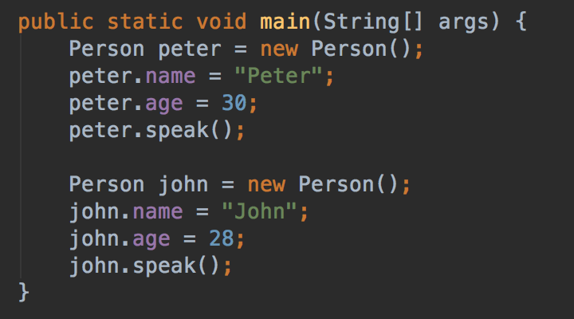
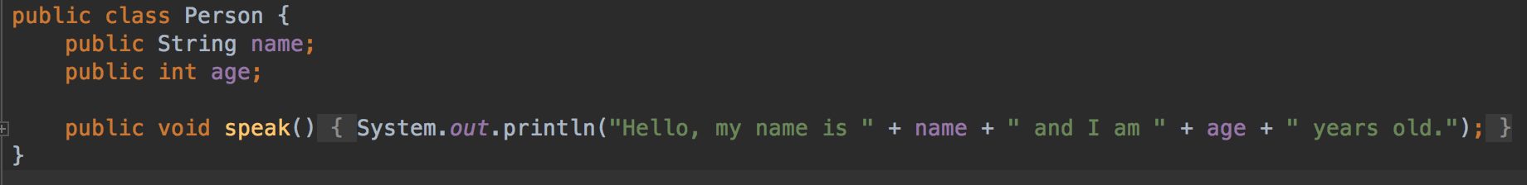
Lesson 4.1
Classes as extended Data Types
A person can have a name, an age and tell about that
Use new Person() to create a new person Object
The Java VM manages memory, so object destruction is not needed.

Slide 30
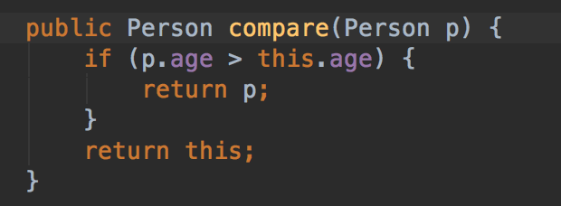
Lesson 4.2
Methods with parameters
A method can also take another object as input.
This one compare the ages of two persons

Slide 31
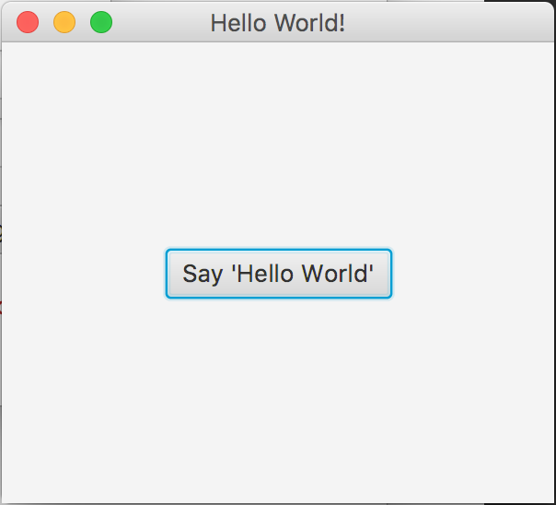
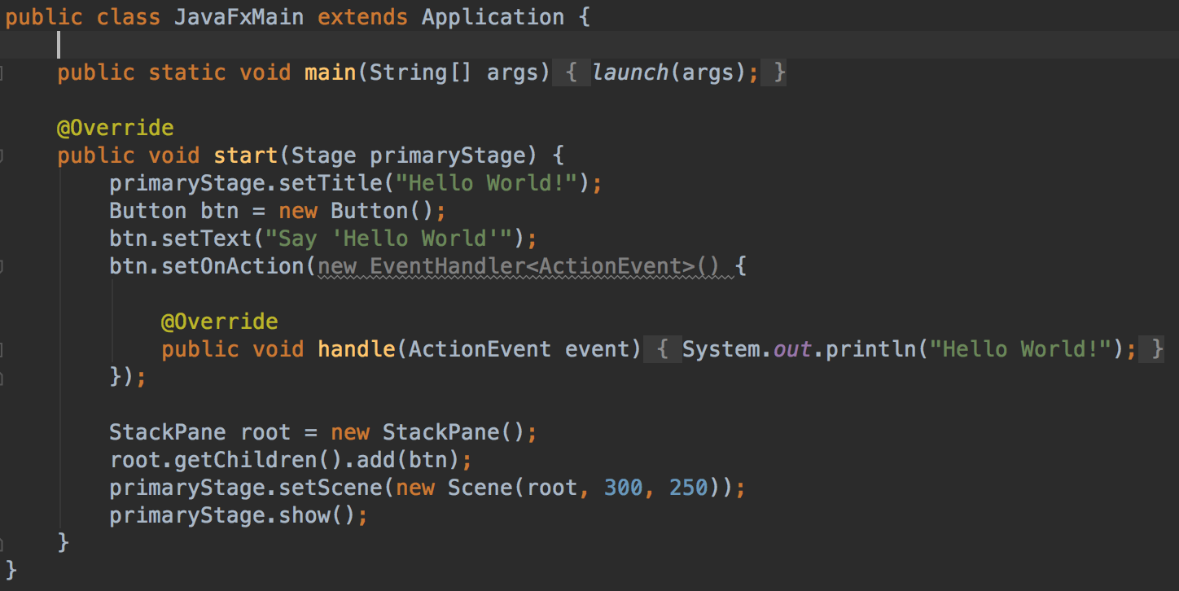
Lesson 4.3
Excurs: JavaFX

Slide 32
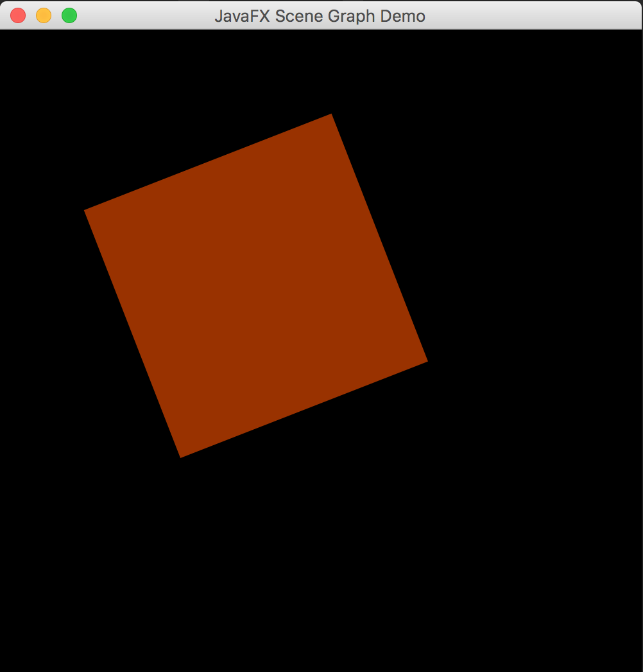
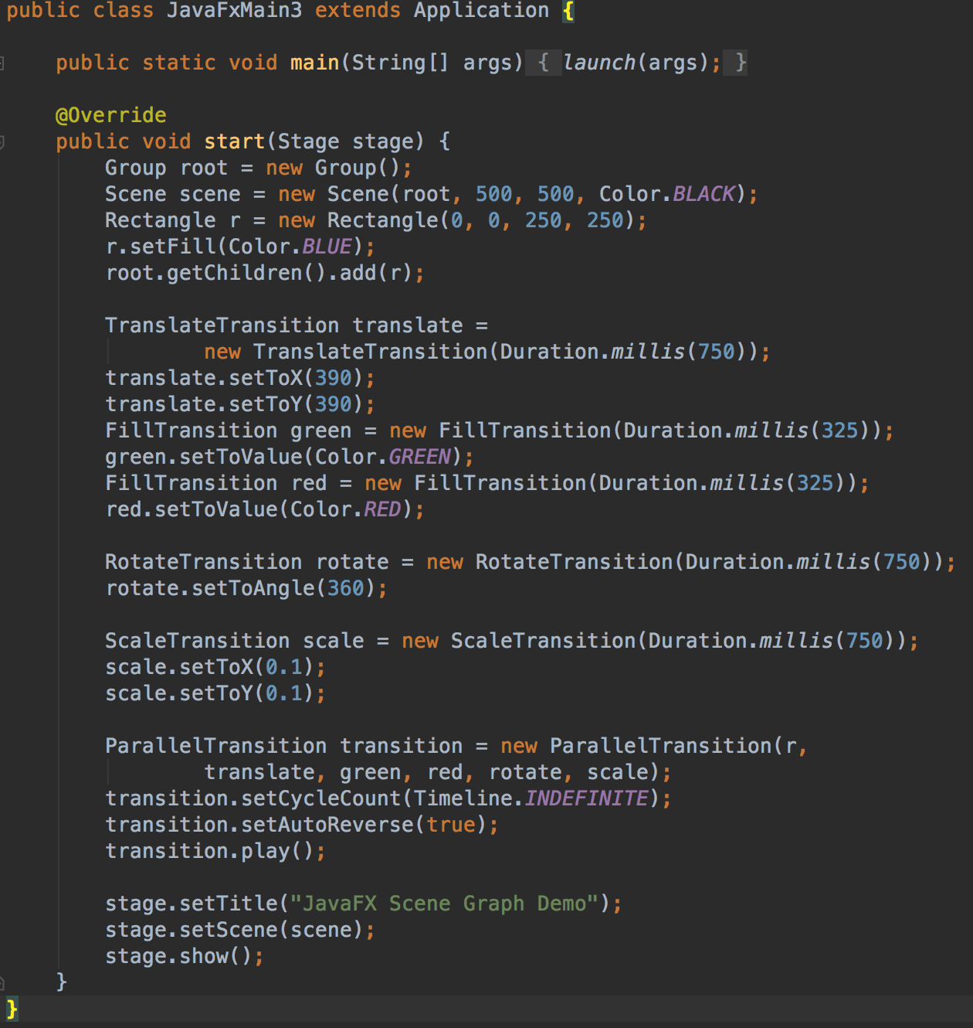
Lesson 4.3
Excurs: JavaFX

Slide 33
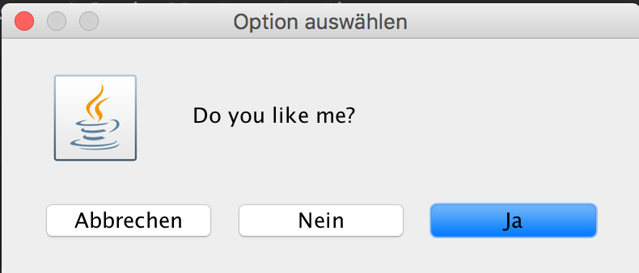
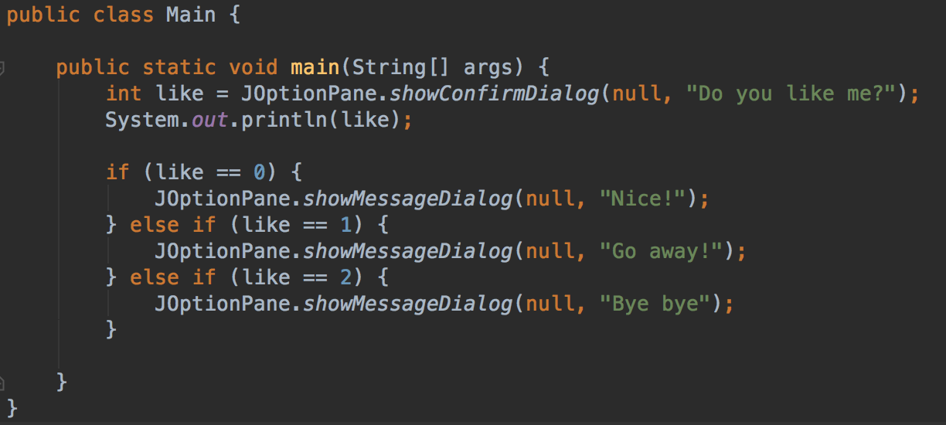
Lesson 4.3
Excurs: Swing

Slide 34
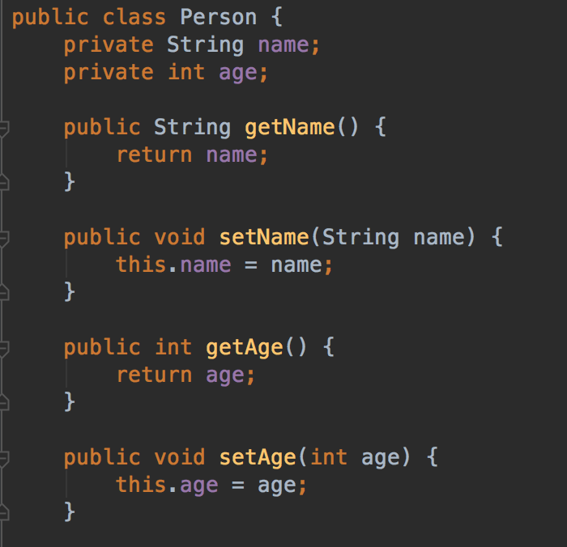
Lesson 4.4
Setter and Getter
It is a good strategy to hide variables from the outside and control access via getters and setters.
E.g. prohibit write access

Slide 35
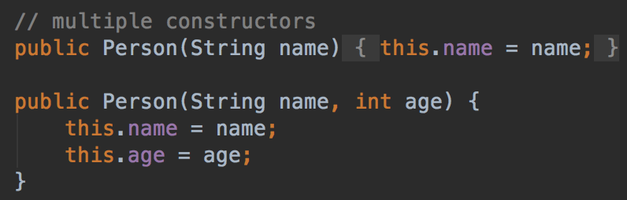
Lesson 4.5
The constructor
The constructor builds a new instance of a class.
Here, both is possible:
new Person(„John“); new Person(„John“, 26);

Slide 36
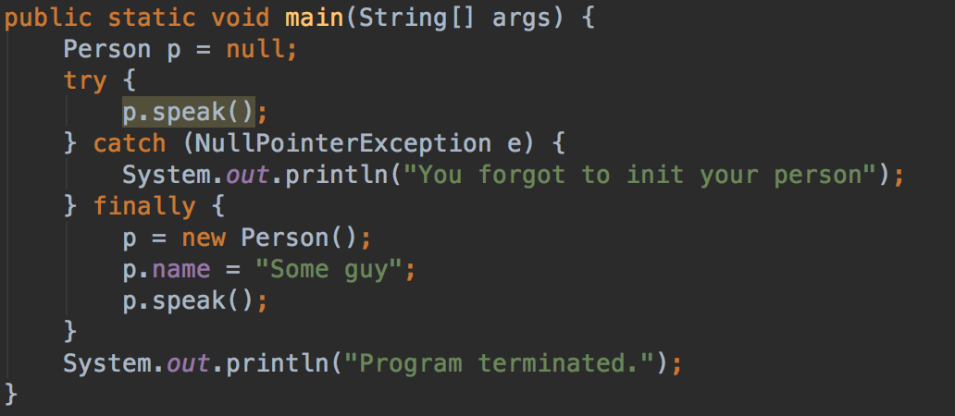
Lesson 4.6
Error Handling
Errors can result in a program stop.
The Java VM throws an Exception. Luckily, this can be caught.
try { op; } catch (Exception e) { handleException; } finally { executeAnyway; }

Slide 37
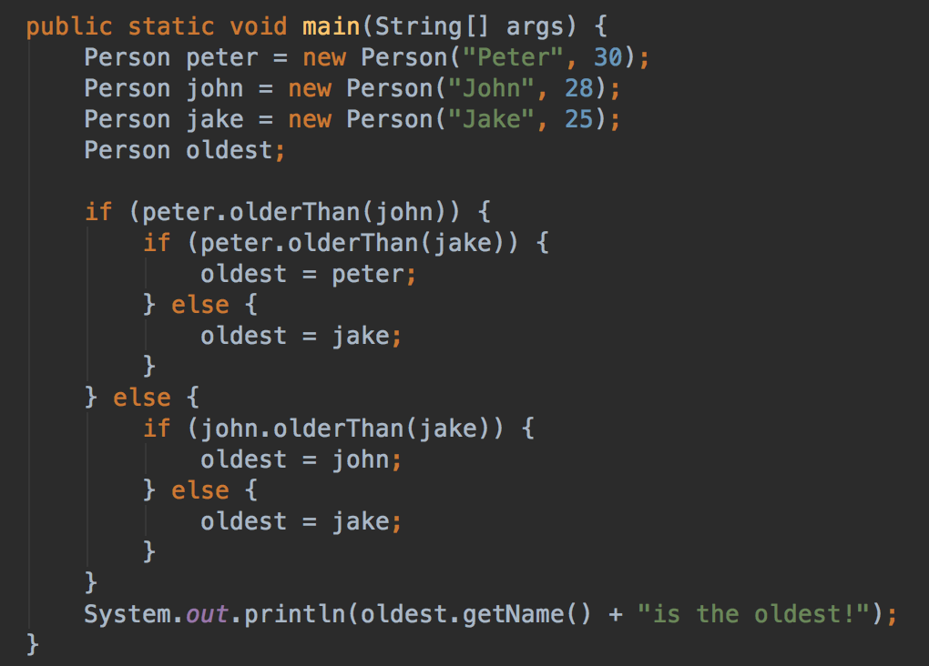
Lesson 4.7
Cascaded If’s
If‘s can be cascaded...

Slide 38
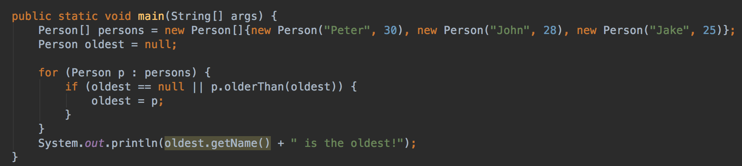
Lesson 4.7
Cascaded If’s
... But better is this one:

Slide 39
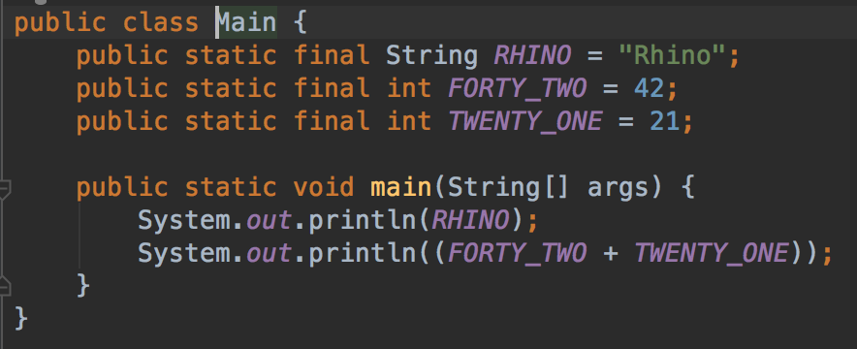
Lesson 4.8
Constants
Constant values cannot be changed.
They act as fixed values.
E.g.
PI = 3.14; ADMIN_ROLE = „admin“; ZA = „South Africa“ CHESS_SIZE = 8; LOTTO = 49;

Slide 40
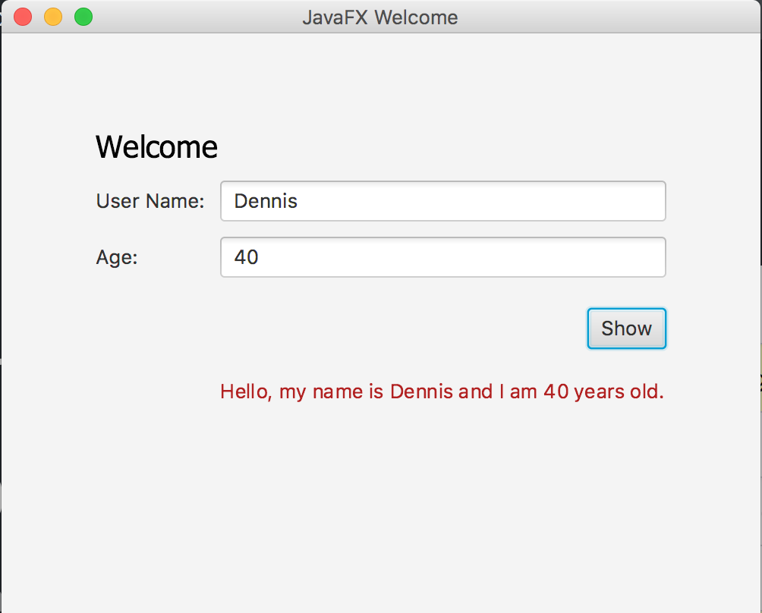
Practice 4
Complete the message dialog given in practice4 to display person data.

Slide 41
Chapter 5
More on Arrays

Slide 42
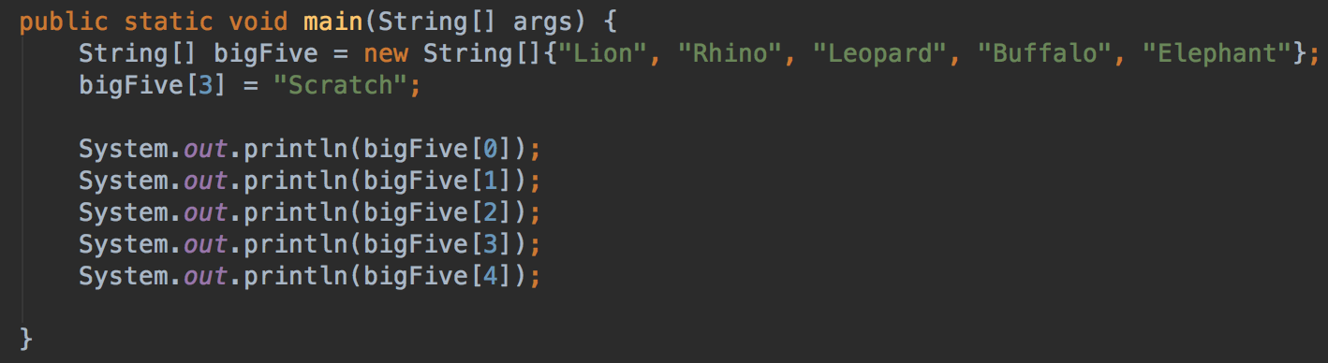
Lesson 5.1
Modify values in an array
Arrays can be manipulated by simply setting a field
bigFive[3] = „Scratch“

Slide 43
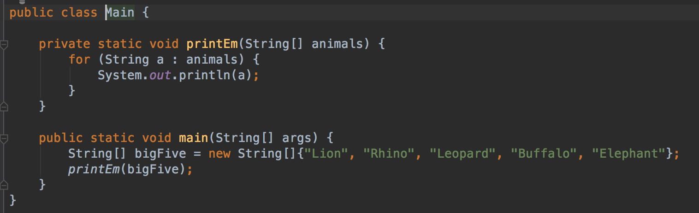
Lesson 5.2
Arrays as Parameter
Arrays can be passed as a parameter. The length does not matter.

Slide 44
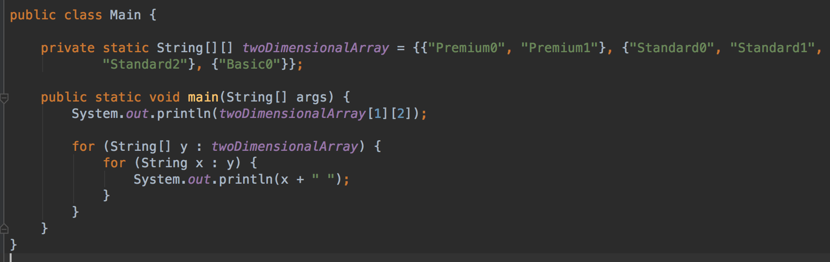
Lesson 5.3
Multi-dimensional arrays in Java
Arrays can contain other arrays.
For example, to model a chess board...

Slide 45
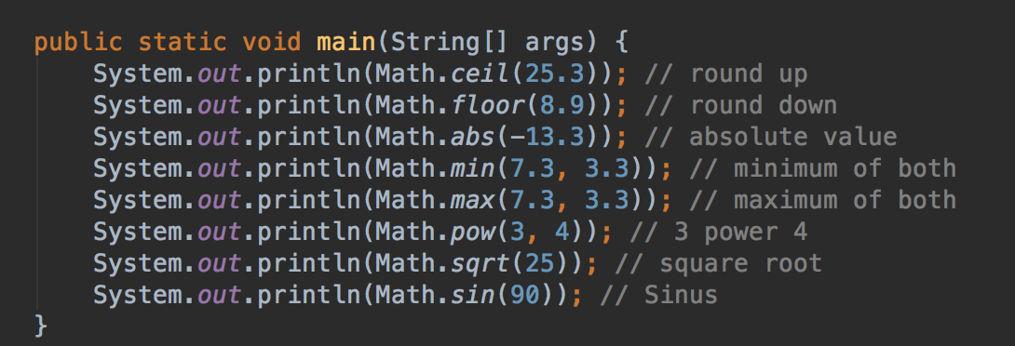
Lesson 5.4
The Math class
This is a class shipped with Java
The Math class brings advanced math operations.

Slide 46
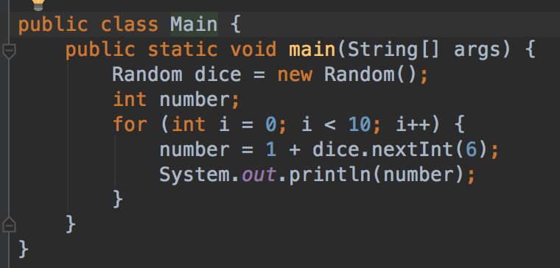
Lesson 5.5
The Random generator
Use this to generate random numbers.
Got an idea how to build a lotto game?

Slide 47
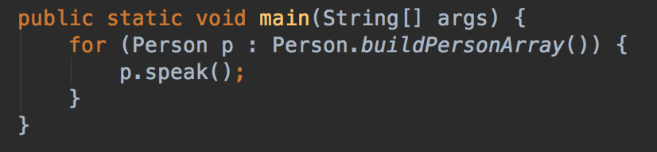
Lesson 5.6
Static
Static variables and methods do not depend on an object instance.
Even more, they can be used to build instances of their class...

Slide 48
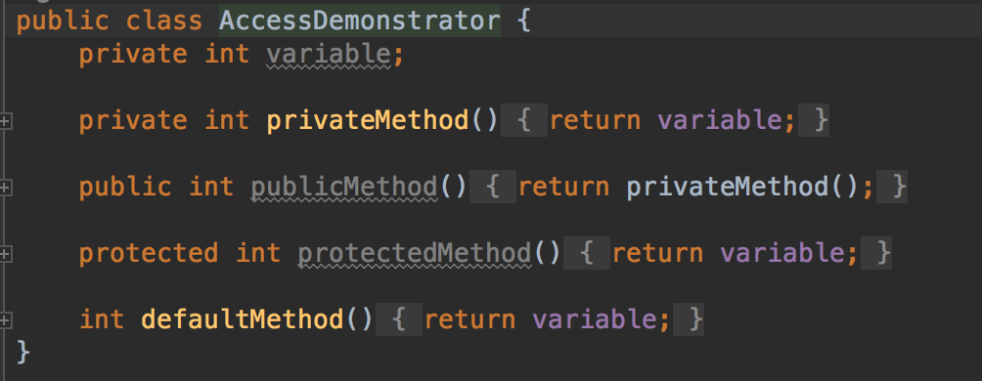
Lesson 5.7
Private, Public, Protected: Access restrictions
Variables can have different visibilities.
private: hidden to the outside public: completely visible protected: visible in hierarchy default: visble in package

Slide 49
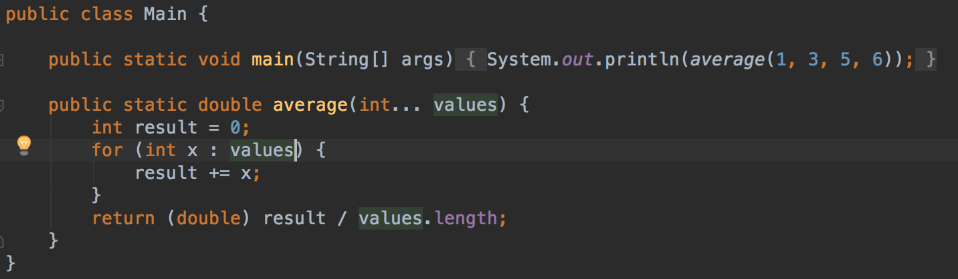
Lesson 5.8
Parameter Lists
The ellipses operator defined a list of parameters from one type, where the length is not set
Must be at the end of the parameter declaration.
Internally handled as an array.

Slide 50
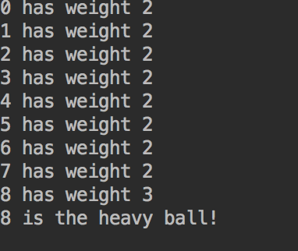
Practice 5
Ball weight game preps: write the data model
This shall become a game with the following rules:
The player sees 9 balls/ circles. Use an array.
One of the balls is heavier than the others.
Use two constants SMALL_WEIGHT = 2 and HEAVY_WEIGHT = 3
Write a method that randomly selects one ball and makes it heavier.
Write a method that finds the heavier ball and prints it‘s array id on the console.

Slide 51
Chapter 6
Inheritance and Polymorphism

Slide 52
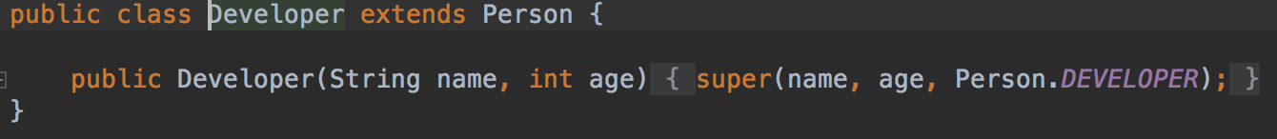
Lesson 6.1
Inheritance with extends
A class can extend another class
It has then all variables and methods.
Only protected or public variables/ methods can be redefined
Here, a Developer is a person.

Slide 53
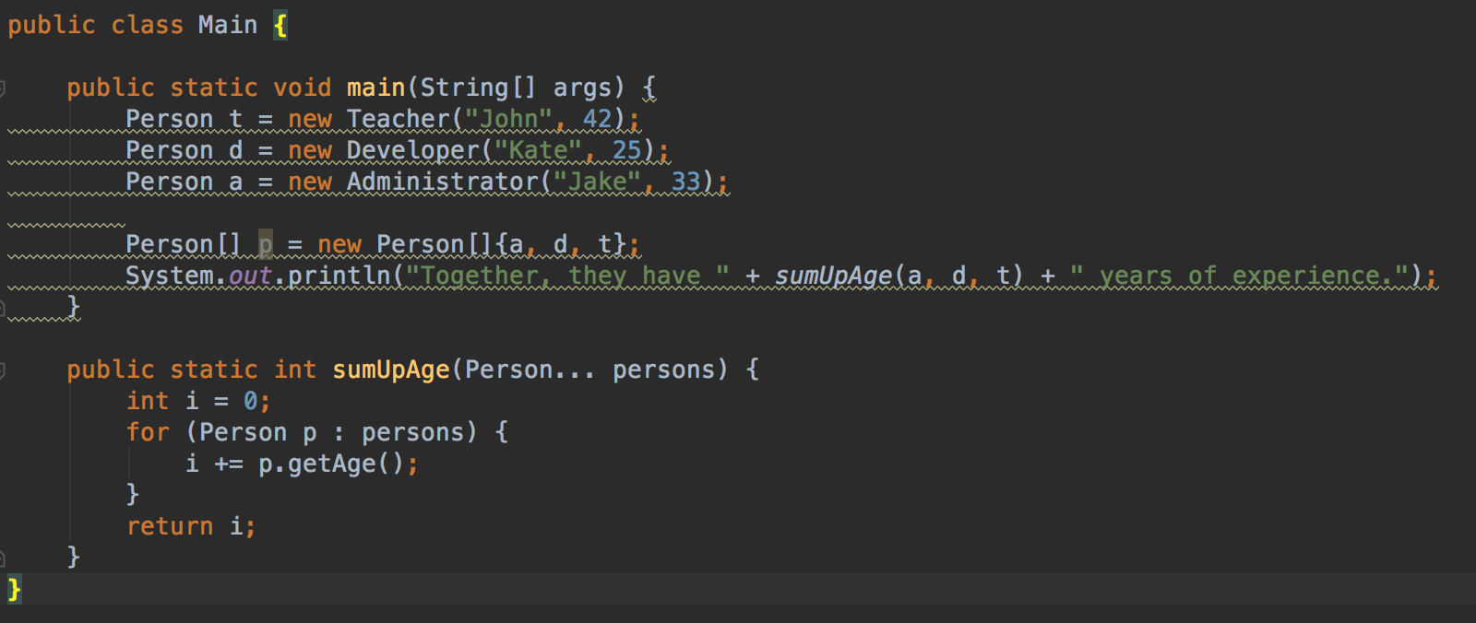
Lesson 6.2
Polymorphism
The sumUpAge() method expects a Person instance. You can put in a Developer, Teacher, Student ...

Slide 54
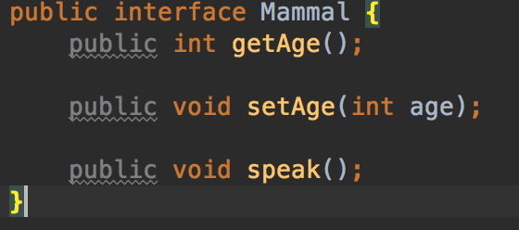
Lesson 6.3
Interfaces
An interface is a template for classes.
Classes have to implement the interface.
Interfaces are contracts for reusability.

Slide 55
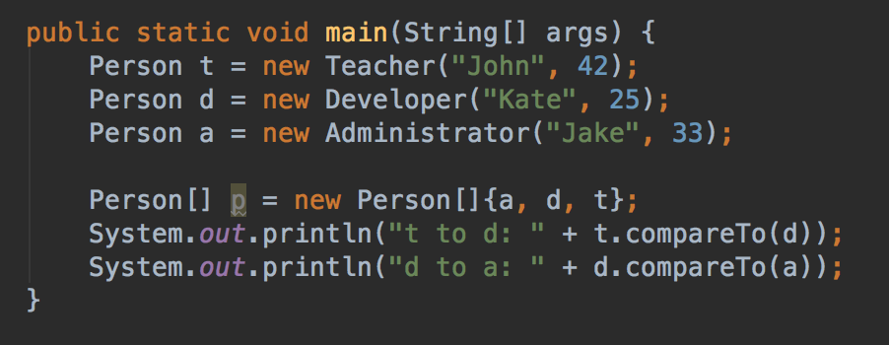
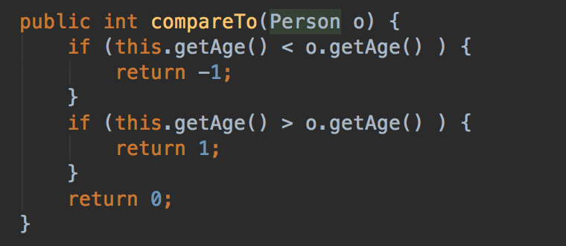
Lesson 6.3
Comparators
Make objects comparable

Slide 56
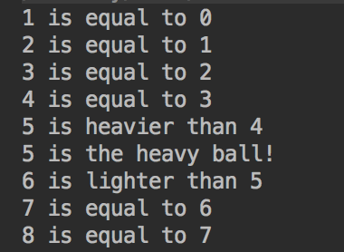
Practice 6
Write a comparator for the balls data type from practice 5.

Slide 57
Chapter 7
More features

Slide 58



Lesson 7.1
final
Final declares variables and classes as non-changeable.
It is not possible to derive from final classes

Slide 59

Lesson 7.2
abstract
An abstract class is a template that cannot be instantiated.

Slide 60

Lesson 7.3
toString()

Slide 61

Lesson 7.4
Composition

Slide 62

Lesson 7.5
Boxed Types

Slide 63

Lesson 7.6
Enumeration
An enum defines the possible states a data type can have.
Can be used like a normal data type.
E.g. Flight state: WAITING, STARTING, FLYING, ARRIVING, LANDED, UNLOAD, DELAYED

Slide 64


Lesson 7.6
Enumeration

Slide 65

Lesson 7.7
Object References
Be careful with object references!
In this example, simply setting the teacher does not affect the student object!
Even worse, the student references an „abandoned“ teacher.
The Garbage Collector cannot clean up the teacher object.
This is a memory leak!

Slide 66

Lesson 7.8
equals()
Object equality is a two-faced thing:
The ==-Operator checks the object reference, thus the identity
==: objects are identical
Equals: objects have equal properties

Slide 67

Practice 7
Congrats! You made it through the Java basics course!
To challenge you, we want you to write a game:
This is actually a math riddle: you have nine balls (or marbles). One of them is heavier than the others. You have a balance weight to weigh them out and are given two tries.
We won‘t use a balance weight, but two colors: Green and Red.

Slide 68

Practice 7
We won‘t use a balance weight, but two colors: Green and Red.
Once two groups of balls are selected, you can compare their weight by clicking the button.

Slide 69

Practice 7
We won‘t use a balance weight, but two colors: Green and Red.
Once two groups of balls are selected, you can compare their weight by clicking the „Show Weight“ button.
You can do this only twice. Then the „Show Weight“ button will disappear and you have to click on the heaviest ball. If you cannot find it, the Game is over.
Solution will be provided in two weeks on GitHub!

Slide 70
Chapter 8
Maven

Slide 71
Chapter 9
Testing

Slide 72
Lesson 9.1
Why Testing?

Slide 73
Lesson 9.2
The JUnit Framework

Slide 74
Lesson 9.3
A simple test

Slide 75
Lesson 9.3
Test-Driven Development

Slide 76
Practice 9

Slide 77
Chapter 10
Working with Spring Boot

Slide 78
Lesson 9.1
The spring.io Website

Slide 79
Lesson 9.2
The spring.io Guides

Slide 80
Lesson 9.3
Building a REST Service

Slide 81
Practice 9

Slide 82
Chapter 10
Java 8

Slide 83
Lesson 8.1
What is new in Java 8?

Slide 84
Lesson 8.2
Lambda Expressions

Slide 85
Practice 9

Slide 86
Further Learning
Patterns
Spring Boot
Test Driven Development
Android

